Slide 1
November 2024
DAYCLI message
Expert Team on Data Development and Stewardship (ET-DDS)

Slide 2

What is the DAYCLI message?
Is a WMO message with a worldwide mission to share, currently at a month frequency, daily values of temperature, precipitation and snow.
It special feature is to exchange high-quality and quality-controlled values of for better climate services

Slide 3
Which Metadata inside the DAYCLI ?
According the FM 94 BUFR 3 07 075: WMO-No. 306, 2019 edition, Updated in 2022)
Time period for each value (beginning time) and time period of displacement
Computation method in use to calculate the average daily temperature So far: 7 methods, capacity to add methods according the practices of the members
Siting Classification for temperature and precipitation sensors classification from high to low quality (from 1 to 5)
Measurement Quality Classification for temperature and precipitation sensors classification from high to low quality (from A to D)
Data Quality Information
0 = Data checked and declared good
1 = Data checked and declared suspect
2 = Data checked and declared aggregated
3 = Data checked and declared out of instrument range
4 = Data checked, declared aggregated, and out of instrument range
5 = Parameter is not measured at the station
6 = Daily value not provided
7 = Data unchecked
8–254 = Reserved
255 = Missing (QC info not available)

Slide 4
DAYCLI history 1/2
Before 2012: Attempts to use SYNOP data for collection of daily parameters. This solution was abandoned due to difficulties on climatological practices around the world (see van den Besselaar et al., 2012)
2012: The Global Climate Observing System (GCOS) Atmospheric Observation Panel for Climate recommends to share, as the CLIMAT messages that transmit monthly observation values, daily observations values
2015: WMO approves the DAYCLI BUFR template 3 07 074 (Manual on Codes WMO-No. 306)
2019-2020: Trial phase for the DAYCLI. It reveals issues and the need to modify the DAYCLI BUFR Template. 20 Members had the intention to participate. 6 Members have exchanged the DAYCLI message through the Global Telecommunication System (GTS) according NOAA (Hong Kong China, Ireland, Japan, Korea, Norway, Spain)
2020: TT-TDCF & ET-DRC & WMO Members are collaborating to define the new DAYCLI BUFR Template. 20 members have contributed to the specifications and the elaboration of the DAYCLI message (ALGERIA, ARGENTINA, BRAZIL, CHILE, ESTONIA, FINLAND, FRANCE, GERMANY, INDIA, INDONESIA, IRELAND, JAPAN, LIBYA, LUXEMBOURG, MOROCCO, PARAGUAY, PERU, SPAIN, SWITZERLAND, URUGUAY and UNITED STATES OF AMERICA)
2022: BUFR Template for the DAYCLI message 3 07 075, that replaces the 3 07 074, is adopted the 13 April, and reported the 15 May into the WMO Manual on Codes. https://github.com/wmo-im/BUFR4/issues/51
Template FM 94 3 07 075 described in the Manual on Code, Bart B Binary Codes, WMO-No. 306:https://community.wmo.int/en/activity-areas/wis/volume-i2

Slide 5
DAYCLI history 2/2
June 2024: EC-78, ET‑DRC and Secretariat/INFCOM‑3
Manual on the WMO Integrated Global Observing System, Annex VIII to the WMO Technical Regulations, 2023 edition, Updated in 2024, WMO-No. 1160, https://library.wmo.int/records/item/55063-manual-on-the-wmo-integrated-global-observing-system
5.1.14 Members should provide daily and monthly summaries (DAYCLI and CLIMAT reports) of observations made at their surface land stations on a monthly basis, according to the Manual on Codes (WMO‑No. 306).
Notes:
1. DAYCLI and CLIMAT reports are to be transmitted by the fifth day of the month.
2. CLIMAT reports require quality control not only of the measurements themselves, but also of their message encoding to ensure their accurate transmission to national, regional and world centres. Quality checks should be made on site and at a central facility designed to detect equipment faults at the earliest stage possible.

Slide 6
Axel Andersson (DWD), DAYCLI evaluation, October/2023
DWD's incoming database contains 697 stations reporting DAYCLI.
625 DAYCLI messages use DAYCLI BUFR template 307074, 72 don't.
20 DAYCLI messages include WIGOS ID.
Additional information:
Rep. of Korea submitted two bulletins with identic data designator (ISCC60 RKSL).
1 bulletin contains CLIMAT, 1 bulletin contains DAYCLI.
Neither BUFR template 307073 is used for CLIMAT, nor 307074 for DAYCLI.
Chile submitted DAYCLI twice. Bulletins with data designator ISCI/ISCJ60 include the WMO station number, bulletins with data designator ISCI/ISCJ40 include WIGOS ID and WMO station number.
As ISCx 01-45 is reserved for CLIMAT, ii=40 must not be used for DAYCLI.
Please note that more stations could have submitted DAYCLI, but were not stored in DWD's database, e.g. due to incorrect data category/sub category or incorrect BUFR table version.
Notes:
The technical issue is about the capacity to exchange globally data in the correct format. We, Meteorological Departments, should use BUFR format to exchange our messages over the GTS, the Global Telecommunication System. But, as you can see, in March 2023, 55% of our stations are still transmitted the CLIMAT message in Traditional ASCII format and not in BUFR format.

Slide 7
Countries Transmitting DAYCLI and Received at NCEI in 2024
Jay Lawrimore, NOAA/NCEI, July 2024
So far, no evaluation in the real world has been made with the new DAYCLI BUFR template (3 07 075) through the WIS (to be verified! )
Notes:
The technical issue is about the capacity to exchange globally data in the correct format. We, Meteorological Departments, should use BUFR format to exchange our messages over the GTS, the Global Telecommunication System. But, as you can see, in March 2023, 55% of our stations are still transmitted the CLIMAT message in Traditional ASCII format and not in BUFR format.

Slide 8
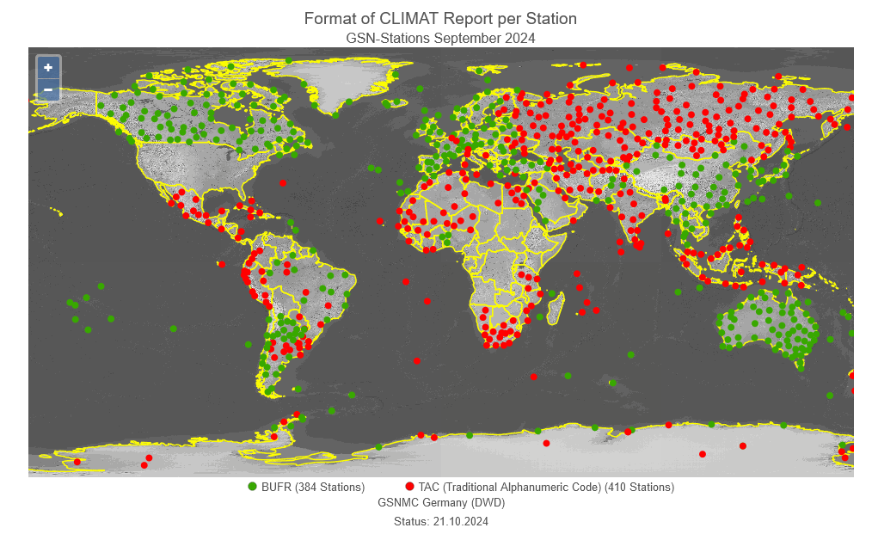
TAC and BUFR current situation for CLIMAT report
https://gcos.dwd.de/DWD-GCOS
Notes:
The technical issue is about the capacity to exchange globally data in the correct format. We, Meteorological Departments, should use BUFR format to exchange our messages over the GTS, the Global Telecommunication System. But, as you can see, in March 2023, 55% of our stations are still transmitted the CLIMAT message in Traditional ASCII format and not in BUFR format.

Slide 9
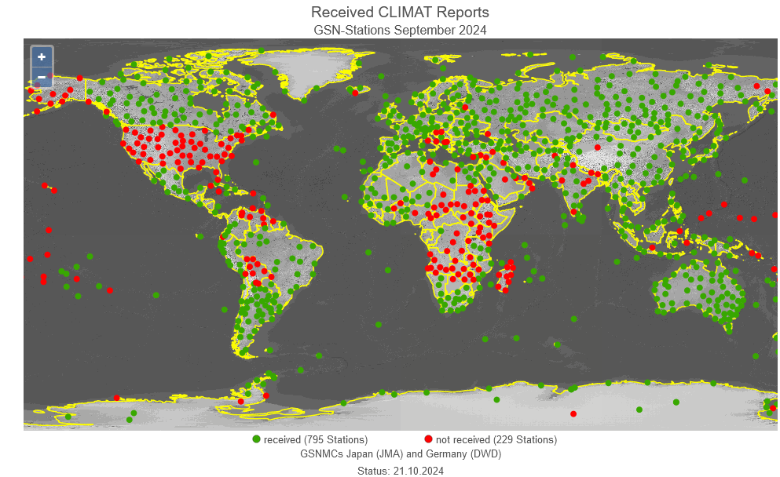
CLIMAT availability September 2024
https://gcos.dwd.de/DWD-GCOS
Notes:
The technical issue is about the capacity to exchange globally data in the correct format. We, Meteorological Departments, should use BUFR format to exchange our messages over the GTS, the Global Telecommunication System. But, as you can see, in March 2023, 55% of our stations are still transmitted the CLIMAT message in Traditional ASCII format and not in BUFR format.

Slide 10
ET-DDS to submit a paper about which stations shall/should transmit CLIMAT and DAYCLI reports through the WIS
Paper intended for SERCOM and INFCOM to tackle this issue on which stations should/shall transmit CLIMAT and DAYCLI messages. The situation is not so clear currently with the deprecated RBCN (Regional Basic Climatological Network).
GBON stations ? RBON stations ?
Draft paper available here: https://github.com/ET-DRC/DAYCLI-message/blob/main/Paper/20240812_Discussion%20of%20requirements%20regarding%20CLIMAT%20and%20DAYCLI%20reporting_DS.docx
Discussion in progress (?) with ET-DDS, GCOS, SERCOM, INFCOM, etc. ( Tim Oakley, Blair Trewin, Krunoslav Premec, Jay Lawrimore, etc.
Notes:
The technical issue is about the capacity to exchange globally data in the correct format. We, Meteorological Departments, should use BUFR format to exchange our messages over the GTS, the Global Telecommunication System. But, as you can see, in March 2023, 55% of our stations are still transmitted the CLIMAT message in Traditional ASCII format and not in BUFR format.

Slide 11
DAYCLI handbook history
June 30, 2022: Meeting INFCOM/SERCOM on “What next for the DAYCLI message?”.
August 15, 2022: first draft of the DAYCLI handbook distributed for initial review by William Wright.
January 20, 2024: SERCOM/ET-DRC send a new DAYCLI handbook draft to INFCOM.
March 20, 2024: INFCOM send back its review of the DAYCLI handbook to ET-DDS.
April 11, 2024: ET-DDS send a new DAYCLI handbook draft to INFCOM.
June 19, 2024: Review of the handbook by Blair Trewin.
July 8, 2024: Inconsistencies revealed and modifications to the 3 07 075 template suggested by ET-DDS (not yet included into the draft DAYCLI handbook).
Latest version of the hanbook is available here: https://github.com/ET-DRC/DAYCLI-message/blob/main/handbook/20240726_DAYCLI_Handbook_Draft_Version%203.docx

Slide 12
Which inconsistencies and which possible enhancements ?
Mail from Denis 26/07/2024 to INFCOM/SERCOM/GCOS:
the handbook still needs decisions on certain issues (see below), consolidation and further review. Personally, I see three issues that need to be resolved before sending any letter to WMO members encouraging them to use the new BUFR template for the DAYCLI. The answers to these issues may lead to modifications in the current DAYCLI BUFR template.
(1) Measuring period and climatological day
The management of Daylight-Saving Time (DST) is not entirely satisfactory. Also, the climatological day information to which the parameters are assigned is not fully defined.
A file explaining the problem with the climatological day is attached (Use case for coding the DAYCLI message.pdf). Review of this explanation is needed too!
(2) Quality Flags
Some questions remain about the need for certain codes. The final list of codes should be decided.
(3) Stations reporting DAYCLI
With the deprecation of the Regional Basic Climatological Network (RBCN) it is not clear how to list, how to register/de-register, and how to maintain stations reporting CLIMAT and DAYCLI.
This statement is also shared by Robkamp Elke (Global Precipitation Climatology Center (GPCC) DWD) and by Tim Oakley (mail from 10/07/2024). This situation may have a negative impact, and may, in the long-term, reduce the number of stations sending the CLIMAT and the DAYCLI messages. A clear statement and clear procedures from the WMO in response to this current situation would seem to be necessary.
Notes:
The technical issue is about the capacity to exchange globally data in the correct format. We, Meteorological Departments, should use BUFR format to exchange our messages over the GTS, the Global Telecommunication System. But, as you can see, in March 2023, 55% of our stations are still transmitted the CLIMAT message in Traditional ASCII format and not in BUFR format.

Slide 14
BUFR Template 3 07 075
0 08 094
Method used to calculate the average daily temperature
Code table 0 08 094
Code figure
0 Average of maximum and minimum values: Tm = (Tx + Tn)/2 (see Note)
1 Average of the 8 observations taken every three hours
2 Average of the 24 hourly observations
3 Weighted average of 3 observations: Tm = (aT1 + bT2 + cT3) (see Note)
4 Weighted average of 3 observations and also maximum and minimum values: Tm = (aT1 + bT2 + cT3 + dTx + eTn) (see Note)
5 Automatic weather station complete integration from minute data
6 Average of the 4 observations taken every six hours
7–254 Reserved
255 Missing value
Note: The letters a, b, c, d and e generically represent the weight associated with the respective
temperature T. The sub-index of T: 1, 2, 3, x and n represent the values measured at different
times or maximum (x) or minimum (n) values.

Slide 15
BUFR Template 3 07 075
0 31 021
Associated field significance
Code table 0 31 021
Code figure
0 = Data checked and declared good
1 = Data checked and declared suspect
2 = Data checked and declared aggregated
3 = Data checked and declared out of instrument range
4 = Data checked, declared aggregated, and out of instrument range
5 = Parameter is not measured at the station
6 = Daily value not provided
7 = Data unchecked
8–254 = Reserved
255 = Missing (QC info not available)

